Slide 1
Fourier transform of sampled functions & Sampling theorem, Aliasing, Obtaining the DFT from the Continuous Transform of a Sampled Function

Slide 2
Image Transforms
Many times, image processing tasks can be best performed in a domain other than the spatial domain.
Key steps
(1) Transform the image
(2) Carry the task(s) in the transformed domain.
(3) Apply inverse transform to return to the spatial domain.

Slide 3
Representative Forward/Inverse Equations
Forward Transformation (discrete case)
Inverse Transformation (discrete case)
forward transformation kernel
inverse transformation kernel

Slide 4
Kernel Properties
A kernel is said to be separable if:
A kernel is said to be symmetric if:

Slide 5
Kernel Properties (cont’d)
Example: exponential kernel:
It is both separable and symmetric:

Slide 6
Trigonometric Fourier Series
Any periodic function f(t) can be expressed as a weighted (infinite) sum of sine and cosine functions of increasing frequency:
basis functions
where
n=1,2,3,…
coefficients of expansion

Slide 7
Trigonometric Fourier Series (cont’d)
Sinusoidals of varying frequency

Slide 8
Trigonometric Fourier Series - Example

Slide 9
Trigonometric Fourier Series - Example

Slide 10
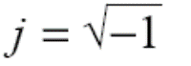
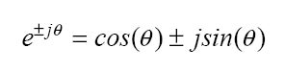
Exponential Fourier Series
complex exponential
Relationship to
trigonometric series:
where
This can also be thought as a decomposition into
sines and cosines as implied by Euler’s formula:

Slide 11
Continuous Fourier Transform (FT)
The Fourier Transform (FT) of a continuous, non-periodic function f(x) is defined as follows:
Given F(u), we can obtain f(x) back using the Inverse Fourier Transform (IFT):
frequency domain
spatial (or time) domain

Slide 12
Interpreting the Fourier Transform (FT)
Inverse Fourier Transform
The Fourier Transform of a function gives us information about its component frequencies!
basis functions
(decompose f(x) in terms of complex
exponentials or equivalently cos/sin
of varying frequencies)
coefficients of
expansion
Forward Fourier Transform
coefficients of expansion

Slide 13
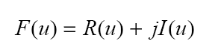
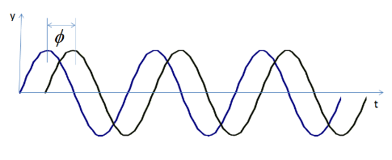
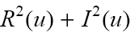
FT - Definitions
In general, F(u) is a complex function:
Magnitude of FT (or spectrum):
Phase of FT:
Magnitude-Phase representation:
Power of f(x): P(u)=|F(u)|²=
strength of that frequency in the function (i.e., amplitude)
how sinusoidals line up (i.e., shift)

Slide 14
Why is FT Useful?
Easier to remove undesirable frequencies in the frequency domain (i.e., frequency domain filtering).
Faster to perform certain operations in the frequency domain than in the spatial domain (e.g., convolution) using the Fast Fourier Transform (FFT)

Slide 15
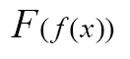
Frequency Filtering: Main Steps
1. Take the FT of f(x):
2. Remove undesired frequencies
by applying a filter:
3. Convert back to spatial domain:

Slide 16
Example: Removing undesirable frequencies
frequency
decomposition
noisy signal
remove high
frequencies
filtered
signal

Slide 17
How do frequencies show up in an image?
Low frequencies correspond to slowly varying pixel intensities (e.g., smooth areas).
High frequencies correspond to quickly varying pixel intensities (e.g., edges)
Original Image
Smoothed or low-passed image (i.e., high frequencies removed)

Slide 18
Common FT Pairs
See handouts posted on the course’s webpage!

Slide 19
Rectangle function
F(u)
Magnitude |F(u)|
zeros of sinc( )
u
u
Note that “negative”
frequencies have no
physical meaning and
only make sense from a
theoretical point of view!
(width W)
where

Slide 20
Duality Property
f(x) F(u)
F(x) f(-u)
Prove it using the definition
of the inverse FT!
Note: if f(u) is even,
then f(-u)=f(u)

Slide 21
Impulse or “delta” function
Definition of delta function:
Continuous
Discrete
constrained to
satisfy:

Slide 22
Impulse (“delta”) (cont’d)
Properties:
Continuous
Discrete

Slide 23
What is the FT of δ(x)?
1
x
u

Slide 24
“Train” of impulses function
An infinite sum of impulses, Δx units apart:

Slide 25
What is the FT of a s(x)?
It is also a “train” of impulses, Δu=1/Δx units apart:

Slide 26
Spatial/frequency shifts (translation)
Special Cases:

Slide 27
Cosine function
FT of the cosine function:
Note: the imaginary part
is zero; this is true for
all real and even f(x)
cos(2πu₀x)
F(u)
Note that “negative”
frequencies only make
sense from a theoretical
point of view!
1/2

Slide 28
Sine function
FT of the sine function:
Note: the real part
is zero; this true for
all real and odd f(x)
imaginary axis
jF(u)
sin(2πu₀x)
Note that “negative”
frequencies only make
sense from a theoretical
point of view!

Slide 29
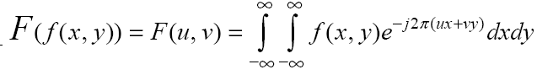
Extending FT in 2D
Forward FT
Inverse FT

Slide 30
2D rectangle function
FT of a 2D rectangle function:
2D sinc()
top view

Slide 31
Discrete Fourier Transform (DFT)
Extending the FT to the DFT requires converting continuous functions into a sequence of discrete values → apply sampling!
f(x) F(u)
x-th sample (i.e., x is now an index)
Δx: sampling step in the spatial domain
(assuming x₀=0)
u-th sample (i.e., u is now an index)
Δu: sampling step in the frequency domain

Slide 32
Representing Sampling Mathematically
Sampling a continuous function f(x) can be represented mathematically by multiplying f(x) with a train of impulses s(x):
x
Δx: sampling step in the spatial domain

Slide 33
What is the FT of s(x)f(x) ?
Using the definition of the FT:
Change the order of integration
with summation

Slide 34
What is the FT of s(x)f(x)? (cont’d)
We will show later that the is periodic with period 1/Δx – i.e., we need to sample one period only.
Assuming N equally spaced samples in the frequency domain, the sampling step Δu would be:
Substituting in we obtain the forward DFT:
u-th sample (i.e., u is now an index)
where

Slide 35
Discrete Fourier Transform (DFT)
Forward DFT
Inverse DFT turns out to be:
Replacing l with u and k with x and using the simpler notation:
u-th sample (i.e., u is now an index)
x-th sample (i.e., x is now an index)

Slide 36
Discrete Fourier Transform (DFT) (cont’d)
Forward DFT:
Inverse DFT:
u-th sample (i.e., u is now an index)
x-th sample (i.e., x is now an index)

Slide 37
Discrete Fourier Transform (DFT) (cont’d)
We will be using the equivalent definition shown below where the 1/N constant appears in the forward DFT instead of the inverse DFT:
Forward DFT
Inverse DFT
u-th sample (i.e., u is now an index)
x-th sample (i.e., x is now an index)

Slide 38
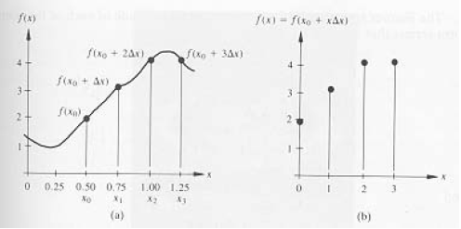
Example
f(0) = 2
f(1) = 3
f(2) = 4
f(3) = 4
13/4
F(0) = 13/4
F(1) = 1/4(-2+j)
F(2) = -1/4
F(3) = -1/4(2+j)
1

Slide 39
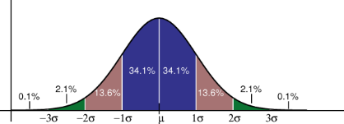
How to correctly sample f(x)?
Example: suppose that you need to obtain N samples from some function f(x), e.g., a Gaussian pdf:
Would the following work?
for(i=0; i<N; i++)
sample[i]=f(i);
No!
Suppose μ=0 and σ=1,
almost all the samples will be zero!

Slide 40
How to correctly sample f(x)? (cont’d)
1. Determine the sampling interval
[μ-3σ, μ+3σ]=[a, b]
2. Determine the sampling step :
Δx = (b-a)/N
3. Obtain the samples:
for(i=0; i<N; i++)
sample[i]=f(a+iΔx);

Slide 41
Extending DFT to 2D
Assuming that f(x,y) is M x N:
Forward DFT
Inverse DFT:
(u-th, v-th) sample (i.e., u and v are now an indices)
Notation:
x
y
(x-th, y-th) sample (i.e., x and y are now an indices)

Slide 42
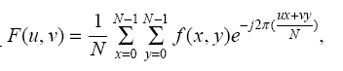
Extending DFT to 2D (cont’d)
Special case: f(x,y) is N x N:
Forward DFT
Inverse DFT
(u-th, v-th) sample (i.e., u and v are now an indices)
(x-th, y-th) sample (i.e., x and y are now an indices)

Slide 43
Properties of 2D DFT & Relationship between spatial and frequency interval, Translation and Rotation, Periodicity, symmetric properties

Slide 44
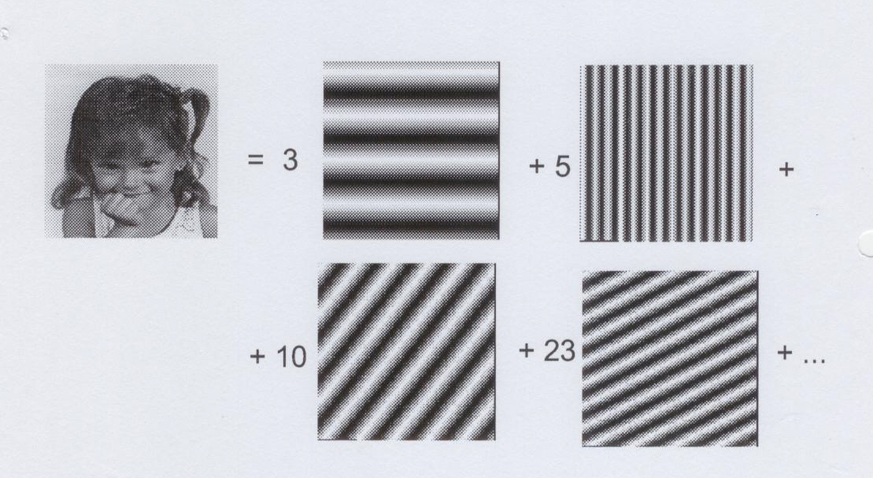
2D DFT Interpretation
2D cos/sin functions

Slide 45
How to visualize DFT?
Typically, we visualize the magnitude (spectrum): |F(u,v)|
Need to apply some “stretching” since the dynamic range of |F(u,v)| is very large, e.g.:
|F(u,v)|
|D(u,v)|
Subsequently
mapping the
values to [0, 255]
will further
improve
visualization!
original image
without stretching
after stretching

Slide 46
How to visualize DFT? (cont’d)
The stretching transformation is needed ONLY for improving spectrum visualization!
It does not change the information conveyed by the spectrum, it only allows us to visualize it better.
The original magnitude |F(u,v)| should be used in all other computations.

Slide 47
DFT Properties: (1) Separability
The 2D DFT can be computed using 1D DFTs:
Forward DFT:
This is because
the exponential
kernel is
separable!

Slide 48
DFT Properties: (1) Separability (cont’d)
Using the kernel separability:
Let’s set:
Then:
1
2D DFT steps:
1. Compute F₁(x,v)
2. Compute F(u,v)
1

Slide 49
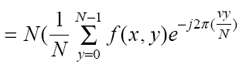
DFT Properties: (1) Separability (cont’d)
How to compute F₁(x,v)?
How to compute F(u,v)?
)
x,v=0,1,2,…N-1
N x
DFT of the rows of f(x,y)
1
u,v=0,1,2,…N-1
DFT of the cols of F₁(x,v)

Slide 50
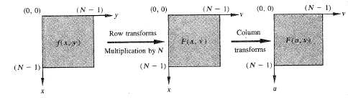
DFT Properties: (1) Separability (cont’d)
Computing 2D DFT using 1D DFTs:
f(x,y)→F₁(x,v)→F(u,v)
1
The same exactly steps (i.e., rows first, columns second) can be used to compute the 2D IDFT using 1D IDFTs.

Slide 51
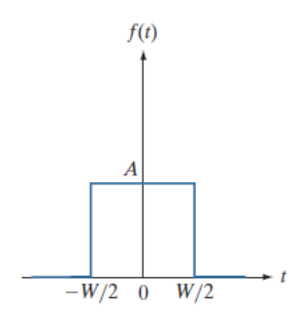
DFT Properties: (2) Periodicity
The DFT and its inverse are periodic with period N:

Slide 52
DFT Properties: (3) Symmetry

Slide 53
DFT Properties: (4) Translation
f(x,y) F(u,v)
Translation in spatial domain:
Translation in frequency domain:
)
N

Slide 54
DFT Properties: (4) Translation (cont’d)
To “see” a full period of the DFT, we need to translate the origin of F(u) to N/2 in 1D or of F(u,v) to (N/2,N/2) in 2D
this is what we see!
|F(u)|
after translation
|F(u-N/2)|

Slide 55
DFT Properties: (4) Translation (cont’d)
Use the following property to preform the translation F(u-N/2,v-N/2):
This results to the following result:
)
N
Set

Slide 56
DFT Properties: (4) Translation (cont’d)
Need to pre-multiply f(x,y) by (-1) ^{x+y} to see a full period.
You need to “undo” the multiplication by (-1) ^{x+y} when you transform your results back to the spatial domain.
f(x,y) (-1)^{x+y} →2D DFT→ Filtering → 2D IDFT →g(x,y) (-1)^{x+y}

Slide 57
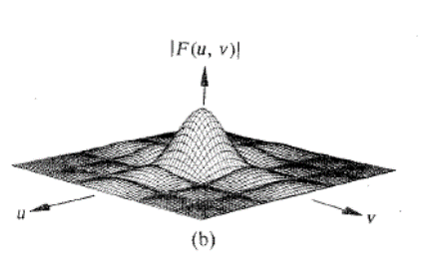

DFT Properties: (4) Translation (cont’d)
sinc
before translation
after translation

Slide 58
DFT Properties: (5) Rotation
Rotating f(x,y) by θ rotates F(u,v) by θ

Slide 59
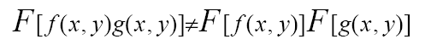
DFT Properties: (6) Addition/Multiplication

Slide 60
DFT Properties: (7) Scale

Slide 61
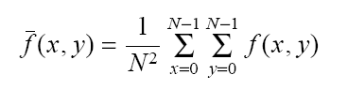
DFT Properties: (8) Average value
Average:
F(u,v) at u=0, v=0:
So:

Slide 62
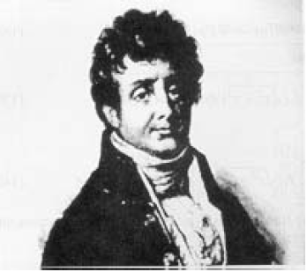
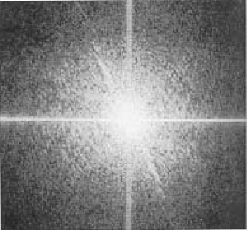
Magnitude and Phase of DFT
What is more important?
Hint: use the inverse 2D DFT to reconstruct the input image using only magnitude or phase information.
magnitude
phase

Slide 63
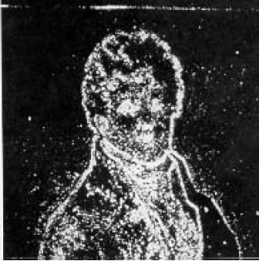
Magnitude and Phase of DFT (cont’d)
Reconstructed image using
magnitude only
(i.e., magnitude determines the
strength of each sinusoidal component)
Reconstructed image using
phase only
(i.e., phase determines
the phase of each sinusoidal component)

Slide 64
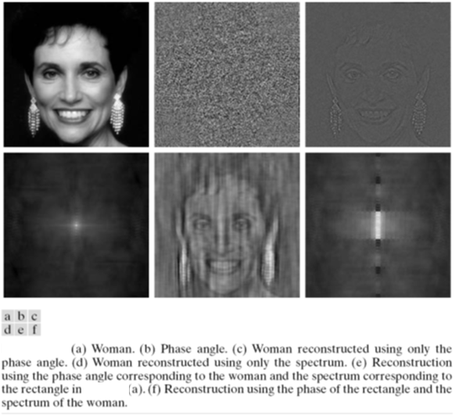
Magnitude and Phase of DFT (cont’d)
phase
only phase
only magnitude
phase (from woman)
magnitude (from rectangle)
phase (from rectangle)
magnitude (from woman)

Slide 65
Fast Fourier Transform FFT & Discrete Cosine Transform

Slide 66
Discrete Cosine Transform
1D Discrete Cosine Transform (DCT)
where and
Inverse DCT

Slide 67
Discrete Cosine Transform
2D Discrete Cosine Transform (DCT)
where and
Inverse DCT

Slide 68
Discrete Cosine Transform
The basis functions of DCT are real. (DFT has complex basis functions.)
DCT has very good energy compaction properties.
DCT can be expressed in terms of DFT, therefore, Fast Fourier Transform implementation can be used.
In the case of block-based image compression, (e.g., JPEG), DCT produces less artifacts along the boundaries than DFT does.

Slide 69
DCT and DFT
N-point DCT of x[n] can be obtained from 2N-point DFT of symmetrically extended x[n].
Symmetric extension:
DFT of :
DCT of :

Slide 70
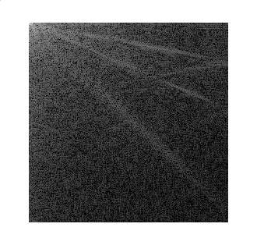
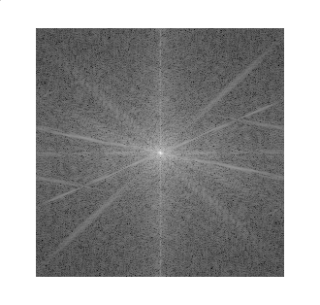
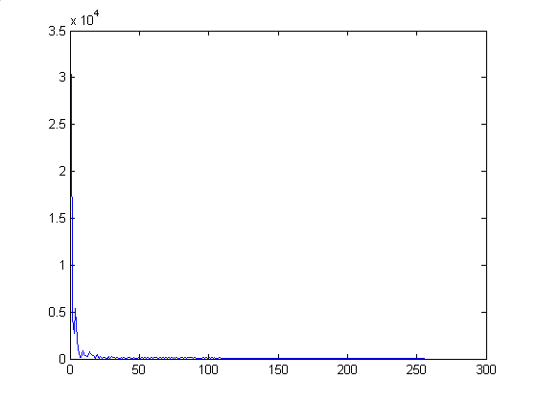
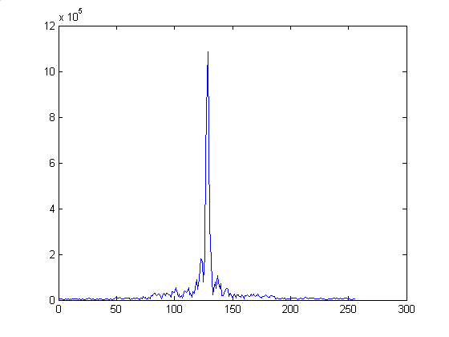
Discrete Cosine Transform
a = imread(‘cameraman.tif’);
DCTa = dct2(a);
DFTa = fft2(a); DFTa = fftshift(DFTa);
figure; imshow(log(abs(DCTa)),[ ]);
figure; imshow(log(abs(DFTa)),[ ]);
figure; plot(abs(DCTa(1,:)));
figure; plot(abs(DFTa(128,:)));
% Also use mesh plots
DCT
DFT

Slide 71
Discrete Cosine Transform
Matrix Representation of DCT

Slide 72
Discrete Cosine Transform
Matrix Representation of Inverse DCT

Slide 73
Discrete Cosine Transform
Inverse DCT matrix is equal to the transpose of DCT matrix!

Slide 74
Discrete Cosine Transform
2D Discrete Cosine Transform (DCT)
where and
Inverse DCT

Slide 75
Discrete Cosine Transform
For two-dimensional signals:

Slide 76
Discrete Cosine Transform
Try in MATLAB:
f=[1 2 3];
Df1 = dct(f)
D=dctmtx(3);
Df2=D*f;
f2=D’*f;
g=[1 2 3; 4 5 6; 7 8 9];
Dg1=dct2(g);
Dg2=D*g*D’;

Slide 77
THANK YOU

